Slide 1
Department of Electronics & Telecommunication Engineering
Presentation
On
Signals & Systems

Slide 2
Introduction to Signals
Signals are variables that carry information.
It is described as a function of one or more independent variables.
Basically it is a physical quantity. It varies with some independent or dependent variables.
Signals can be One-dimensional or multi-dimensional.
Notes:
Natural Systems: These are systems like the ecosystem, blood system and solar system.
Human-made System: These systems include not designed and designed physical systems such as: machines, industrial plants, telecomunication infrastructure networks, computer storage systems and modern sculptures.
Abstract Systems: Every conceptual model is an abstract system, for example, traffic system models and computer programs are both types of modeled systems. They can be the product of identification, design or invention.
Descriptive and Normative Systems: They relates to human and other living system activity, an example of these are; plans, bus/train timetable, ethical systems.

Slide 3
Signal: A function of one or more variables that convey information on the nature of a physical phenomenon.
Examples: v(t),i(t),x(t),heartbeat, blood pressure, temperature, vibration.
One-dimensional signals: function depends on a single variable, e.g., speech signal
Multi-dimensional signals: function depends on two or more variables, e.g., image

Slide 4
Classification of signals
Continuous-time and discrete-time signals
Periodic and non-periodic signals
Casual and Non-casual signals
Deterministic and random signals
Even and odd signals

Slide 5
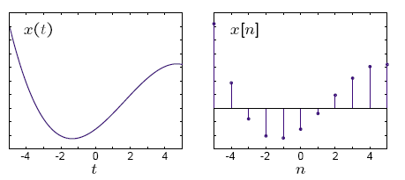
Continuous time (CT) & discrete time (DT) signals:
CT signals take on real or complex values as a function of an independent variable that ranges over the real numbers and are denoted as x(t).
DT signals take on real or complex values as a function of an independent variable that ranges over the integers and are denoted as x[n].
Note the subtle use of parentheses and square brackets to distinguish between CT and DT signals.

Slide 6
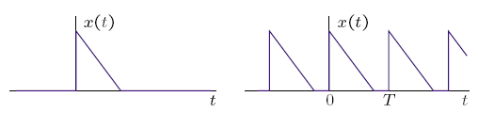
Periodic & Non-periodic Signals
Periodic signals have the property that
x(t + T) = x(t) for all t.
The smallest value of T that satisfies the definition is called the period.
Shown below are an non-periodic signal (left) and a periodic signal (right).

Slide 7


Causal &Non-causal Signals:
A causal signal is zero for t < 0 and
non-causal signal is zero for t > 0
Right- and left-sided signals:
A right-sided signal is zero for t < T and a left-sided signal is zero for t > T where T can be positive or negative.

Slide 8
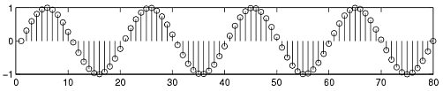
Deterministic & Random Signals
Deterministic signals :
Behavior of these signals is predictable w.r.t time
There is no uncertainty with respect to its value at any time.
These signals can be expressed mathematically.
For example x(t) = sin(3t) is deterministic signal.

Slide 9

Random Signals:
Behavior of these signals is random i.e. not predictable w.r.t time.
There is an uncertainty with respect to its value at any time.
These signals can’t be expressed mathematically.
For example:Thermal Noise generated is non deterministic signal(Random Signals)

Slide 10
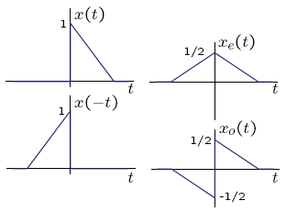
Even & Odd Signals
Even signals xe(t) and odd signals xo(t) are defined as
xe(t) = xe(−t) and xo(t) = −xo(−t).
Any signal is a sum of unique odd and even signals. Using
x(t) = x_{e}(t)+x_{o}(t) and x(−t) = x_{e}(t) − x_{o}(t), yields
x_{e}(t) =0.5(x(t)+x(−t)) and x_{o}(t) =0.5(x(t) − x(−t)).

Slide 11
Classification of signals (cont.)
Even & Odd Signals:
Even:
x(−t) = x(t)
x[−n] = x[n]
Odd:
x(−t) = −x(t)
x[−n] = −x[n]
Any signal x(t) can be expressed as
x(t) = xe(t) + xo(t) )
x(−t) = xe(t) − xo(t)
where
xe(t) = 1/2(x(t) + x(−t))
xo(t) = 1/2(x(t) − x(−t))

Slide 12
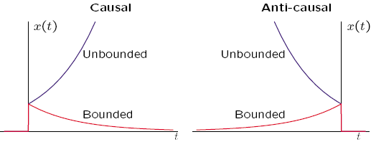
Bounded &Unbounded Signals:
Every system is bounded, but meaningful signal is always bounded

Slide 13
Power and Energy Signals
Power Signal
Infinite duration
Normalized power is finite and non-zero
Normalized energy averaged over infinite time is infinite
Mathematically tractable
Energy Signal
Finite duration
Normalized energy is finite and non-zero
Normalized power averaged over infinite time is zero
Physically realizable

Slide 14
Elementary signals
Step function
Impulse function
Ramp function

Slide 15
Unit Step function:

Slide 16
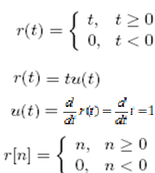
Unit impulse function:
Unit ramp function:

Slide 17
What is a System?
Systems process input signals to produce output signals.
Examples:
A circuit involving a capacitor can be viewed as a system that transforms the source voltage (signal) to the voltage (signal) across the capacitor
A CD player takes the signal on the CD and transforms it into a signal sent to the loud speaker
A communication system is generally composed of three sub-systems, the transmitter, the channel and the receiver. The channel typically attenuates and adds noise to the transmitted signal which must be processed by the receiver

Slide 18
How is a System Represented?
A system takes a signal as an input and transforms it into another signal
In a very broad sense, a system can be represented as the ratio of the output signal over the input signal
That way, when we “multiply” the system by the input signal, we get the output signal
This concept will be firmed up in the coming weeks
Input signal
x(t)
System
Output signal
y(t)

Slide 19
Types of Systems
Causal & Non-causal
Linear & Non Linear
Time Variant &Time-invariant
Stable & Unstable
Static & Dynamic

Slide 20
Causal Systems
Causal system : A system is said to be causal if the present value of the output signal depends only on the present and/or past values of the input signal.
Example: y[n]=x[n]+1/2x[n-1]

Slide 21
Non-causal Systems
Non-causal system : A system is said to be anticausal if the present value of the output signal depends only on the future values of the input signal.
Example: y[n]=x[n+1]+1/2x[n-1]

Slide 22
Linear & Non Linear Systems
A system is said to be linear if it satisfies the principle of superposition
For checking the linearity of the given system, firstly we check the response due to linear combination of inputs
Then we combine the two outputs linearly in the same manner as the inputs are combined and again total response is checked
If response in step 2 and 3 are the same,the system is linear othewise it is non linear.

Slide 23
Time Invariant and Time Variant Systems
A system is said to be time invariant if a time delay or time advance of the input signal leads to a identical time shift in the output signal.

Slide 24
Linear Time-Invariant Systems
Special importance for their mathematical tractability
Most signal processing applications involve LTI systems
LTI system can be completely characterized by their impulse response

Slide 25
Stable & Unstable Systems
A system is said to be bounded-input bounded-output stable (BIBO stable) if every bounded input results in a bounded output.
i.e.

Slide 26
Stable & Unstable Systems
Example: The system represented by
y(t) = A x(t) is unstable ; A˃1
Reason: let us assume x(t) = u(t), then at every instant u(t) will keep on multiplying with A and hence it will not be bonded.

Slide 27

Static Systems
A static system is memoryless system
It has no storage devices
its output signal depends on present values of the input signal
For example

Slide 28
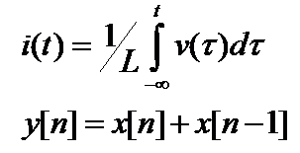
Dynamic Systems
A dynamic system possesses memory
It has the storage devices
A system is said to possess memory if its output signal depends on past values and future values of the input signal

Slide 29
Memoryless System
A system is memoryless if the output y[n] at every value of n depends only on the input x[n] at the same value of n
Example :
Square
Sign
counter example:
Ideal Delay System

Slide 30
Discrete-Time Systems
Discrete-Time Sequence is a mathematical operation that maps a given input sequence x[n] into an output sequence y[n]
Example Discrete-Time Systems
Moving (Running) Average
Maximum
Ideal Delay System
x[n]
T{.}
y[n]

Slide 31
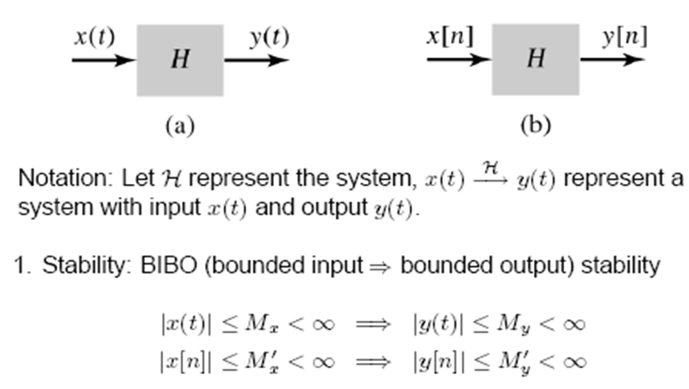
System Properties

Slide 32
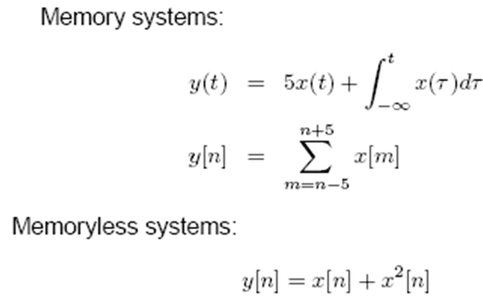
2.Memory /Memoryless:
Memory system: present output value depend on future/past input.
Memoryless system: present output value depend only on present input.
Example:

Slide 33
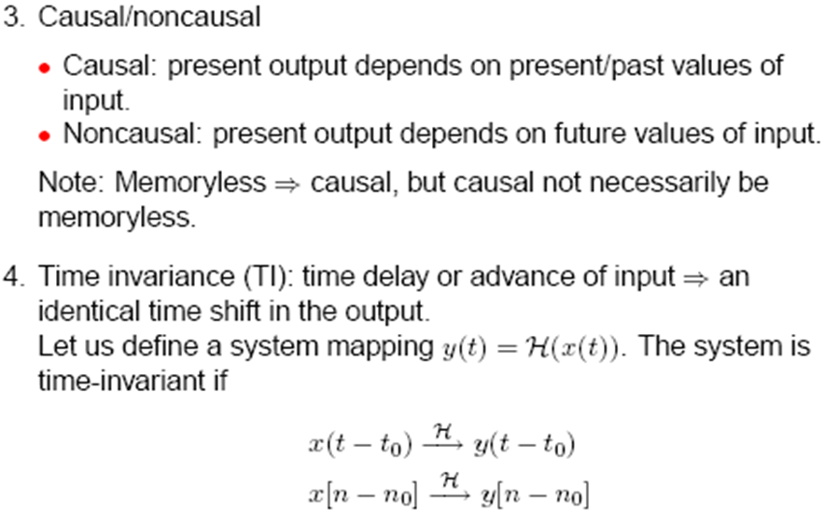

Slide 34
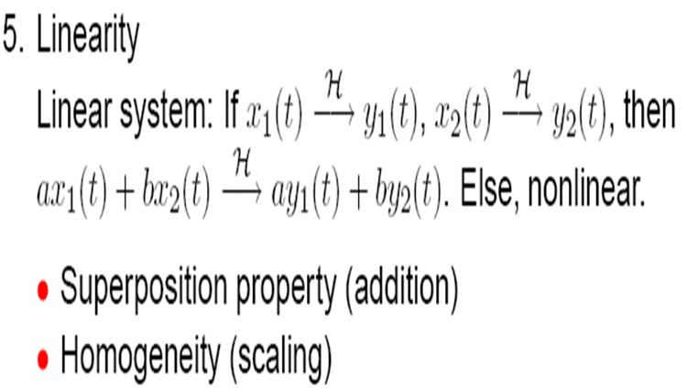

Slide 35
Properties of a System:
On this course, we shall be particularly interested in signals with certain properties:
Causal: a system is causal if the output at a time, only depends on input values up to that time.
Linear: a system is linear if the output of the scaled sum of two input signals is the equivalent scaled sum of outputs
Time-invariance: a system is time invariant if the system’s output is the same, given the same input signal, regardless of time.
These properties define a large class of tractable, useful systems and will be further considered in the coming lectures

Slide 36
Thank You..!!

